Slide 1

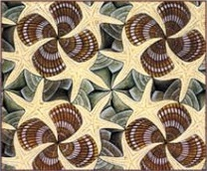
Design Patterns
April 2012
Tin Bui-Huy
(huytin@gmail.com)

Slide 2
04/10/15 11/08/26
Agenda
UML
What is Design Patterns?
Adapter
Singleton
Factory method
Abstract Factory
Decorator
Observer
Command
Template Method
Composite
Prototype
Facade
MVC
Exercises

Slide 3
04/10/15 11/08/26
Classes - Interfaces
# size: Size
- visibility: boolean
Class
Interface
Class Name (italic if abstract)
Interface Name
<<Interface>>
Window
Window
+ display()
+ hide()
+ display()
+ hide()
Attributes
Operations
Operations
+ public
# protected
- private
~ package
/ derived
Reduced form
Window

Slide 4
04/10/15 11/08/26
Associations
House
Window
1
# type: Type
+ windows: Window[]
# size: Size
- visibility: boolean
windows
*
+ display()
+ hide()
+ display()
+ hide()
know the relationship
0..1 | Optional (Zero or one)
1 | Exactly one instance
0..* or * | Zero or more instances
1..* | At least one
3 | Three only
2..6 | Two to six

Slide 5
04/10/15 11/08/26
Aggregation and Composition
Container
Aggregation
Not have a strong life cycle dependency
➔ The container is destroyed, its contents are not
Team
Employee
1
# name: String
+ employees: Employee[]
# name: String
- age: short
employees
*
+ showMembers()
+ calculateSalary()
Composition
Has a strong life cycle dependency
If the container is destroyed, every instance that it contains is destroyed as well
Car
Wheel
1
# kind: Type
+ wheels: Whee[]
# size: Size
- status: Status
wheels
4
+ start()
+ stop()
+ run()
Notes:
Aggregation is a specialization of association, specifying a whole-part relationship between two objects.
Composition is a stronger form of aggregation where the whole and parts have coincident lifetimes

Slide 6
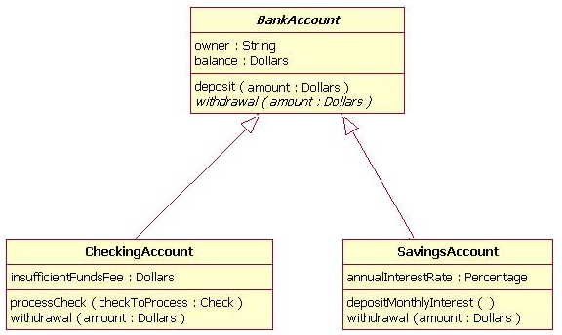
04/10/15 11/08/26
Inheritance/Generalization

Slide 7
04/10/15 11/08/26
Realization
<<interface>>
List
LinkedList
ArrayList

Slide 8
04/10/15 11/08/26
Agenda
UML
What is Design Pattern?
Adapter
Singleton
Factory method
Abstract Factory
Decorator
Observer
Command
Template Method
Composite
Prototype
Facade
MVC
Exercises

Slide 9
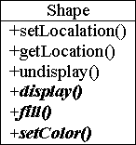




An Example
Shape

Slide 10
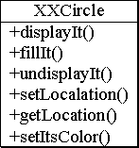
An Example (cont.)
Shape
?

Slide 11
An Example (cont.)
Shape
Target
Adapter
Adaptee
Circle
- c : XXCircle
+ setLocation() + getLocation() + undisplay() + display() + fill() + setColor()
1
1

Slide 12
What is Design Pattern?
A design pattern offers guidelines on when, how, and why an implementation can be created to solve a general problem in a particular context.
“Design patterns help you learn from others' successes instead of your own failures.”
From Mark Johnson.

Slide 13
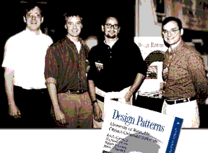
History of Design Patterns
Gamma, Helm, Vlissides,
and Johnson
... the Gang of Four (GOF)
In 1995, published their now famous book titled "Design Patterns, Elements of Reusable Object-Oriented Software"
GOF cataloged software design patterns and brought these concepts into the mainstream

Slide 14
Design Patterns
Solutions to commonly occurring design problems
Help create flexible and reusable designs
Isolate changes in your code
Larger scope than a single class or algorithm
Describes the circumstances in which the pattern is applicable
Language Independent

Slide 15
Essential Properties of a Pattern
Pattern Name
Motivation
  Problem
    Describes a situation
  Solution
    Describes the elements that make up the design
    Their relationships, responsibilities, and collaborations
Applicability
  When is the pattern applied?
Consequences
  The costs and benefits of applying the pattern

Slide 16
How Can Patterns Be Applied?
A program can apply many patterns
A pattern can be applied in many different parts
Many patterns can be used together

Slide 17
Design Pattern Categories (cont.)
 |  | Purpose
 |  | Creational | Structural | Behavioral
 | Class | Factory Method | Adapter | Interpreter Template Method
 | Object | Abstract Factory Builder Prototype Singleton | Adapter Bridge Composite Decorator Facade Proxy | Chain of Responsibility Command Iterator Mediator Memento Flyweight Observer State Strategy Visitor
Relationship

Slide 18
Object Pattern Example
Shape
Circle
- c : XXCircle
+ setLocation() + getLocation() + undisplay() + display() + fill() + setColor()
1
1

Slide 19
Class Pattern Example
Shape
Circle
+ setLocation() + getLocation() + undisplay() + display() + fill() + setColor()

Slide 20
Frequency of Use
Creational Patterns
Pattern | Description | Freq
Abstract Factory | Creates an instance of several families of classes | 5
Builder | Separates object construction from its representation | 2
Factory Method | Creates an instance of several derived classes | 5
Prototype | A fully initialized instance to be copied or cloned | 3
Singleton | A class of which only a single instance can exist | 4

Slide 21
Frequency of Use
Structural Patterns
Pattern | Description | Freq
Adapter | Match interfaces of different classes | 4
Bridge | Separates an object’s interface from its implementation | 3
Composite | A tree structure of simple and composite objects | 4
Decorator | Add responsibilities to objects dynamically | 3
Facade | A single class that represents an entire subsystem | 5
Flyweight | A fine-grained instance used for efficient sharing | 1
Proxy | An object representing another object | 4

Slide 22
Frequency of Use
Behavioral Patterns
Pattern | Description | Freq
Chain of Resp. | A way of passing a request between a chain of objects | 2
Command | Encapsulate a command request as an object | 4
Interpreter | A way to include language elements in a program | 1
Iterator | Sequentially access the elements of a collection | 5
Mediator | Defines simplified communication between classes | 2
Memento | Capture and restore an object's internal state | 1

Slide 23
Frequency of Use
Behavioral Patterns (cont.)
Pattern | Description | Freq
Observer | A way of notifying change to a number of classes | 5
State | Alter an object's behavior when its state changes | 3
Strategy | Encapsulates an algorithm inside a class | 4
Template Method | Defer the exact steps of an algorithm to a subclass | 3
Visitor | Defines a new operation to a class without change | 1

Slide 24
Contents
UML
What is Design Patterns?
Adapter
Singleton
Factory method
Abstract Factory
Decorator
Observer
Command
Template Method
Composite
Prototype
Facade
MVC
Exercises

Slide 25
Adapter
Intent
  Convert the interface of a class into another interface clients expect

Slide 26
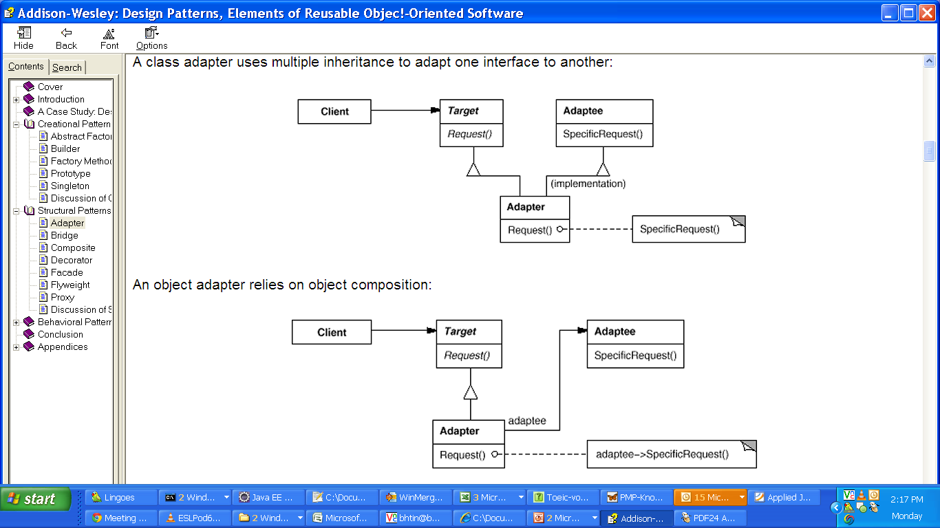
Adapter
Structure
  Class Adapter

Slide 27
Adapter
Structure
  Object Adapter

Slide 28
Adapter
Applicability
  You want to use an existing class, and its interface does not match the one you need
  You want to create a reusable class that cooperates with unrelated or unforeseen classes, that is, classes that don't necessarily have compatible interfaces

Slide 29
Contents
UML
What is Design Patterns?
Adapter
Singleton
Factory method
Abstract Factory
Decorator
Observer
Command
Template Method
Composite
Prototype
Facade
MVC
Exercises

Slide 30
Singleton
Intent
Ensure a class only has one instance
  E.g.
  Class to contain the connection between a client and its server
  Class to contain information of current user

Slide 31
Singleton
Structure
MySingleton
- static instance: MySingleton …
- MySingleton() + static getInstance() : MySingleton …
Constructor
must be
private
static getInstance() MySingleton() {
if (instance == null) {
instance = new MySingleton();
}
return instance;
}

Slide 32
Singleton
Applicability
  There must be exactly one instance of a class
  When the sole instance should be extensible by subclassing

Slide 33
Singleton
Consequences
  ☑ Controlled access to sole instance
  ☑ Reduced name space
    Is an improvement over global variables
  ☑ Permits a variable number of instances
  ☑ More flexible than class operations

Slide 34
Contents
UML
What is Design Patterns?
Adapter
Singleton
Factory method
Abstract Factory
Decorator
Observer
Command
Template Method
Composite
Prototype
Facade
MVC
Exercises

Slide 35
Factory Method
Problem
  Consider a Pizza Store System
  Each store in the system has its own way to create its pizzas

Slide 36
Factory Method
Solution
public abstract class PizzaStore {
public Pizza orderPizza() {
Pizza pizza = createPizza();
bake(pizza);
box(pizza);
return pizza;
}
// factory method
protected abstract Pizza createPizza();
}
public class ChicagoPizzaStore extends PizzaStore {
protected Pizza createPizza() {
return new ChicagoPizza();
}
}

Slide 37
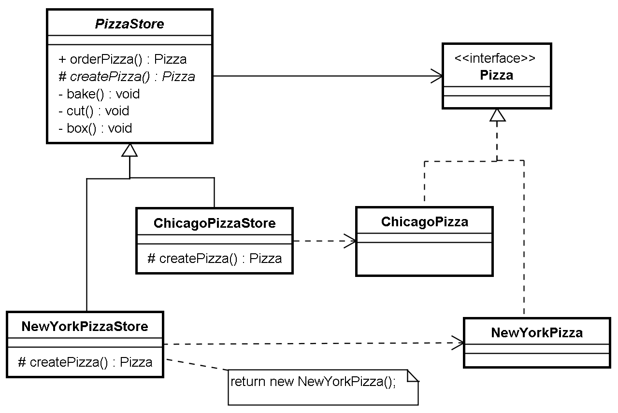
Factory Method
Solution

Slide 38
Factory Method
Intent
  Define an interface for creating an object
  Let subclasses decide which class to instantiate

Slide 39
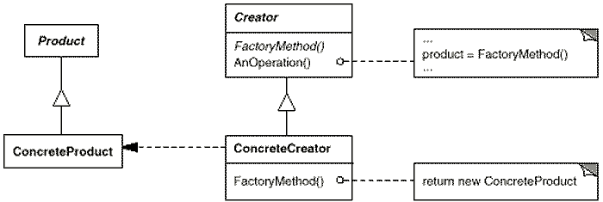
Factory Method
Structure

Slide 40
Factory Method
Participants
  Product (Pizza)
    Defines the interface of objects the factory method creates.
  ConcreteProduct (ChicagoPizza)
    Implements the Product interface.

Slide 41
Factory Method
Participants
  Creator (PizzaStore)
    Declares the factory method, which returns an object of type Product
    May also define a default implementation of the factory method that returns a default ConcreteProduct object.
    May call the factory method to create a Product object.
  ConcreteCreator (ChicagoPizzaStore)
    Overrides the factory method to return an instance of a ConcreteProduct.

Slide 42
Factory Method
Applicability
  A class can't anticipate the class of objects it must create
  A class wants its subclasses to specify the objects it creates

Slide 43
Factory Method
Consequences
  ☑ Provides hooks for subclasses
  ☑ Connects parallel class hierarchies

Slide 44
Contents
UML
What is Design Patterns?
Adapter
Singleton
Factory method
Abstract Factory
Decorator
Observer
Command
Template Method
Composite
Prototype
Facade
MVC
Exercises

Slide 45
Abstract Factory
Problem
  Update your Pizza Store System to support many types of products

Slide 46
Abstract Factory
Solution
  Temporary solution
public abstract class PizzaStore {
public Pizza orderPizza() {
Pizza pizza = createPizza();
bake(pizza);
box(pizza);
return pizza;
}
public Hotdog orderHotdog() {
Hotdog hotdog = createHotdog();
bake(hotdog);
box(hotdog);
return hotdog;
}
// factory method
protected abstract Pizza createPizza();
protected abstract Hotdog createHotdog();
}

Slide 47
Abstract Factory
Solution – temporary solution
public abstract class PizzaStore {
public Pizza orderPizza() {
Pizza pizza = createPizza();
bake();
box();
return pizza;
}
public Pizza orderHotdog() {
Pizza pizza = createHotdog();
bake();
box();
return pizza;
}
}
Public class PizzaStore {
FoodFactory factory;
public PizzaStore(FoodFactory factory) {
this.factory = factory;
}
public Pizza orderPizza() {
Pizza pizza = factory.createPizza();
bake(pizza);
box(pizza);
return pizza;
}
public Hotdog orderHotdog() {
Hotdog hotdog = factory.createHotdog();
bake(hotdog);
box(hotdog);
return hotdog;
}
}
interface FoodFactory {
Pizza createPizza();
Hotdog createHotdog();
}
protected abstract Pizza createPizza();
protected abstract Pizza createHotdog();

Slide 48
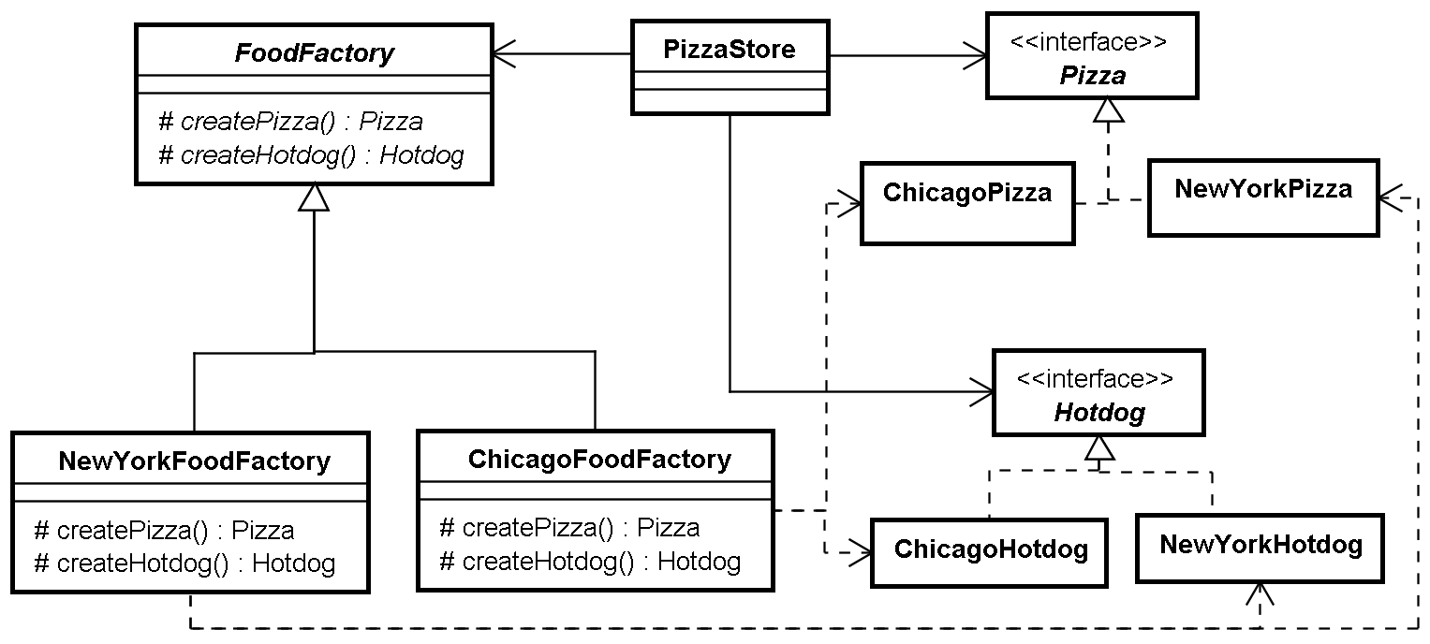
Abstract Factory
Solution

Slide 49
Abstract Factory
Intent
  Provide an interface for creating families of related or dependent objects without specifying their concrete classes

Slide 50

Abstract Factory
Structure

Slide 51
Abstract Factory
Applicability
  A system should be independent of how its products are created, composed, and represented
  A system should be configured with one of multiple families of products
  A family of related product objects is designed to be used together, and you need to enforce this constraint
  You want to provide a class library of products, and you want to reveal just their interfaces, not their implementations

Slide 52
Abstract Factory
Consequences
  ☑ Isolates concrete classes
    Isolates clients from implementation classes
    Clients manipulate instances through their abstract interfaces
  ☑ Makes exchanging product families easy
  ☑ Promotes consistency among products
    Enforce application to use objects from only one family at a time
  ☒ Supporting new kinds of products is difficult
    Supporting new kinds of products requires extending the factory interface

Slide 53
Contents
UML
What is Design Patterns?
Adapter
Singleton
Factory method
Abstract Factory
Decorator
Observer
Command
Template Method
Composite
Prototype
Facade
MVC
Exercises

Slide 54
Decorator
Problem
  In Starbuzz Coffee, there are some kinds of coffee such as DarkRoast, Espresso, Decaf...
  In addition to your coffee, you can also ask for several condiments like steamed milk, soy, and mocha (otherwise known as chocolate), and have it all topped off with whipped milk.
  Starbuzz Coffee charges a bit for each of these, so they really need to get them built into their order system.

Slide 55
Decorator
First attempt
Beverage
getDescription()
cost()
// Other methods
Espresso
Decaf
HouseBlend
DarkRoast
cost()
cost()
cost()
cost()

Slide 56
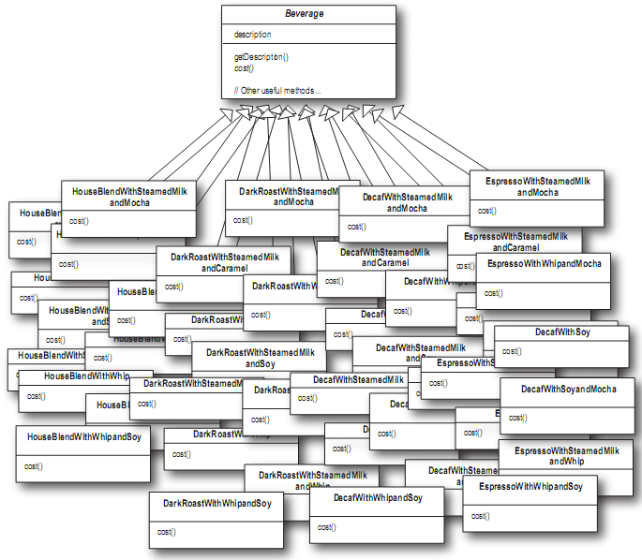
Decorator
Add condiments support
Class explosion!

Slide 57
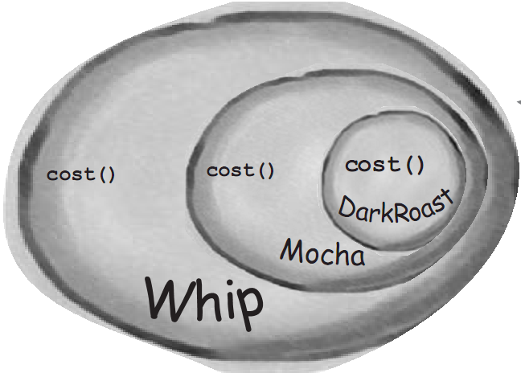
Decorator
Redesign with Decorator pattern
  Start with our DarkRoast object
  Decorate with Mocha
  And then with Whip

Slide 58
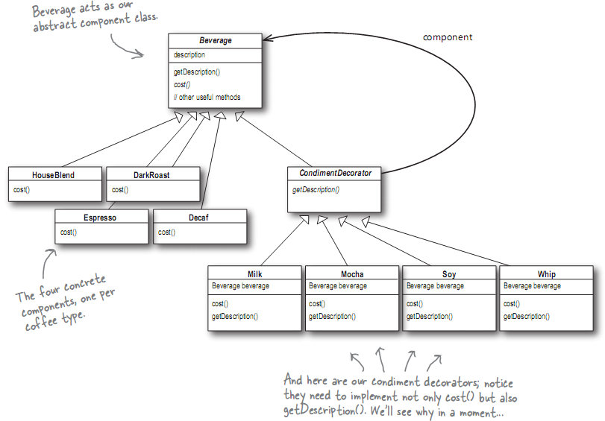
Decorator
Solution

Slide 59
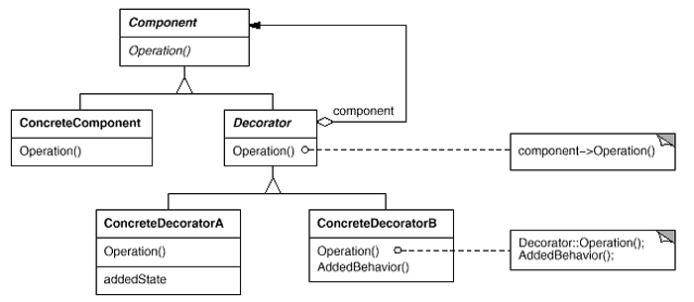
04/10/15 11/08/26
Decorator
Structure

Slide 60
04/10/15 11/08/26
Decorator
Applicability
  To add responsibilities to individual objects dynamically and transparently, that is, without affecting other objects
  Decorate objects dynamically at runtime with as many decorators as we like
  For responsibilities that can be withdrawn
  When extension by subclassing is impractical

Slide 61
04/10/15 11/08/26
Decorator
Consequences
  ☑ More flexibility than static inheritance
  ☑ Avoids feature-laden classes high up in the hierarchy
  ☒ A decorator and its component aren't identical
  ☒ Lots of little objects

Slide 62
Decorator
Real world example
  Java I/O
FileInputStream
BufferredInputStream
LineNumberInputStream

Slide 63
Contents
UML
What is Design Patterns?
Adapter
Singleton
Factory method
Abstract Factory
Decorator
Observer
Command
Template Method
Composite
Prototype
Facade
MVC
Exercises

Slide 64
Observer
Intent
  Define a one-to-many dependency between objects so that when one object changes state, all its dependents are notified and updated automatically

Slide 65
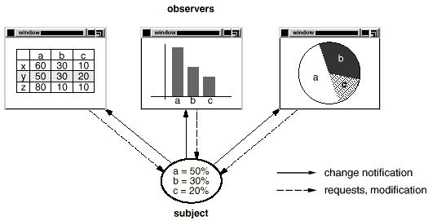
Observer
Problem
  Need to maintain consistency between related objects
  Don't want to achieve consistency by making the classes tightly coupled
  Example:

Slide 66
Observer
Solution
// View is an interface
// Notify these guys
// if data change
View[] observers;
a=50%
b=30%
c=20%

Slide 67
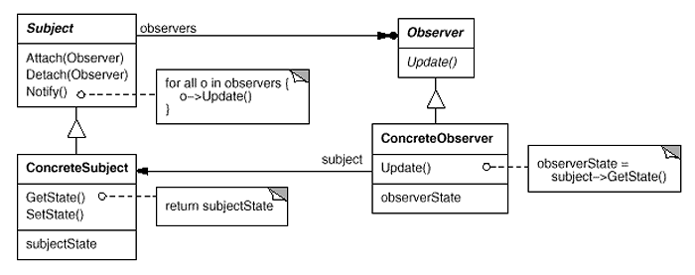
Observer
Structure

Slide 68
Observer
Participants
  Subject
    Knows its observers
    Provides an interface for attaching and detaching Observer objects
  Observer
    Defines an updating interface for objects that should be notified of changes in a subject

Slide 69
Observer
Participants
  ConcreteSubject
    Stores state of interest to ConcreteObserver objects
    Sends a notification to its observers when its state changes
  ConcreteObserver
    Maintains a reference to a ConcreteSubject object
    Stores state that should stay consistent with the subject's

Slide 70
Observer
Applicability
  When an abstraction has two aspects, one dependent on the other
    Encapsulating these aspects in separate objects lets you vary and reuse them independently.
  When a change to one object requires changing others
  When an object should be able to notify other objects without making assumptions about who these objects are
    In other words, you don't want these objects tightly coupled

Slide 71
Observer
Consequences
  ☑ Abstract coupling between Subject and Observer
  ☑ Support for broadcast communication
  ☒ Unexpected updates

Slide 72
Observer
Observer Pattern in java
  java.util.Observable class
  java.util.Observer interface

Slide 73
UML
What is Design Patterns?
Adapter
Singleton
Factory method
Abstract Factory
Decorator
Observer
Command
Template Method
Composite
Prototype
Facade
MVC
Exercises

Slide 74
Command
Problem
  Need issue requests to objects without knowing operation being requested
  For example, user interface toolkits include objects like buttons and menus that carry out a request in response to user input. But the toolkit can't implement the request explicitly in the button or menu, because only applications that use the toolkit know what should be done on which object. As toolkit designers we have no way of knowing the receiver of the request or the operations that will carry it out

Slide 75
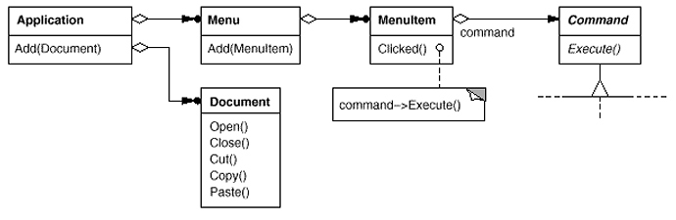
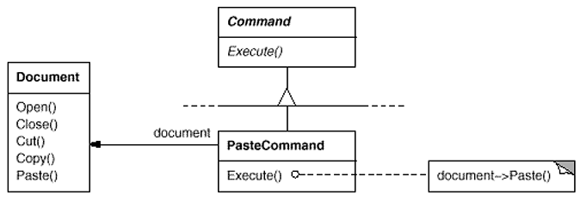
Command
Solution

Slide 76
Command
Intent
  Encapsulate a request as an object
  Letting you parameterize clients with different requests
  Queue or log requests
  Support undoable operations

Slide 77
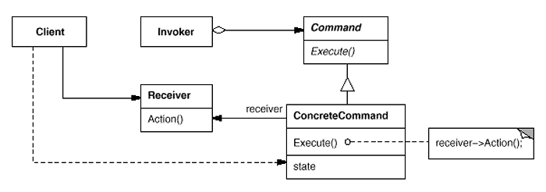
Command
Structure

Slide 78
Command
Applicability
  Parameterize objects by an action to perform
  Specify, queue, and execute requests at different times
  Support undo
    must have an added Unexecute operation that reverses the effects of a previous call to Execute
  Support logging changes so that they can be reapplied in case of a system crash

Slide 79
Command
Consequences
  ☑ Decouples the objects
  ☑ Can assemble commands into a composite command
  ☑ Easy to add new Commands

Slide 80
UML
What is Design Patterns?
Adapter
Singleton
Factory method
Abstract Factory
Decorator
Observer
Command
Template Method
Composite
Prototype
Facade
MVC
Exercises

Slide 81
04/10/15 11/08/26
Template Method
Intent
  Define the skeleton of an algorithm in an operation
  Defer some steps to subclasses

Slide 82
04/10/15 11/08/26
Template Method
Problem
Client
Database
query
Oracle
SQLServer
…

Slide 83
04/10/15 11/08/26
Template Method
Temporary Solution
Client
QueryTemplate
+ query(sql:String):Object
query
QueryOracle
+ query(sql:String):Object
QuerySQLServer
+ query(sql:String):Object

Slide 84
04/10/15 11/08/26
Template Method
Solution
Template method
Object doQuery(dbName:String,
querySpec:String) {
String dbCommand;
dbCommand=formatConnect(dbName);
// open connection
//…
dbCommand = formatSelect(querySpec);
// perform query
//…
// return dataset
}
Client
query
QueryTemplate
+ doQuery(dbName:String, querySpec:String):Object # formatConnect() # formatSelect()
QueryOracle
# formatConnect() # formatSelect()
QuerySQLServer
# formatConnect() # formatSelect()

Slide 85
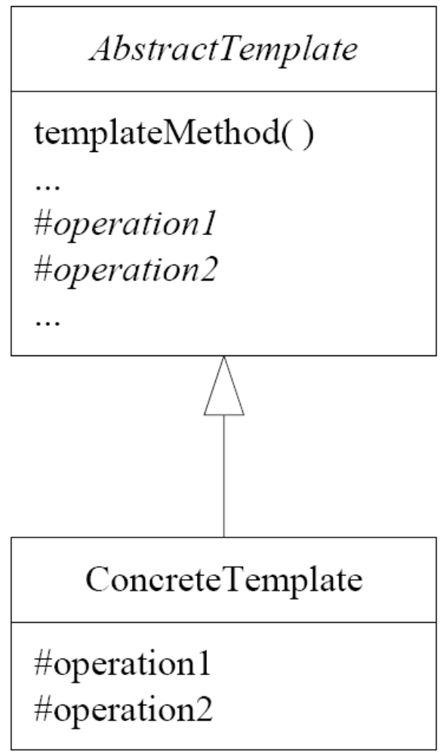
04/10/15 11/08/26
Template Method
Structure
templateMethod( ) {
...
operation1();
…
operation2();
...
}

Slide 86
04/10/15 11/08/26
Template Method
Applicability
  To implement the invariant parts of an algorithm and left subclasses implement behavior.
  When common behavior among subclasses should be factored and localized in a common class
  To control subclasses extensions by using "hook" operations

Slide 87
04/10/15 11/08/26
Agenda
UML
What is Design Patterns?
Adapter
Singleton
Factory method
Abstract Factory
Decorator
Observer
Command
Template Method
Composite
Prototype
Facade
MVC
Exercises

Slide 88
04/10/15 11/08/26
Composite
Intent
  There are single things and groups of things that you want to treat the same way.
  The groups of things are made up of other groups and of single things
Shape
C
C
A
B
C
B
A
Single
Group

Slide 89
04/10/15 11/08/26
Composite
Motivation
Graphic
Draw()
Client
Single
Graphic
…
Text
Draw()
Rectangle
Draw()
Line
Draw()

Slide 90
04/10/15 11/08/26
Composite
Problem
Graphic
Client
Draw()
graphics
Single
Graphic
Picture
graphics Graphic[]
Draw() Add(Graphic) Remove(Graphic) GetChild(int)
…
Text
Rectangle
Line
Draw()
Draw()
Draw()
Composite
Graphic

Slide 91
04/10/15 11/08/26
Composite
Solution
Graphic
Draw()
Client
graphics
Component
Leaf
…
Text
Draw()
Rectangle
Draw()
Line
Draw()
Picture
graphics Graphic[]
Draw()
forall g in graphics {
g.Draw()
}
Composite
Remove(Graphic g)
Add(Graphic g)
GetChild(int index)
Remove(Graphic g)
Add(Graphic g)
GetChild(int index)
Add g to list of graphics

Slide 92
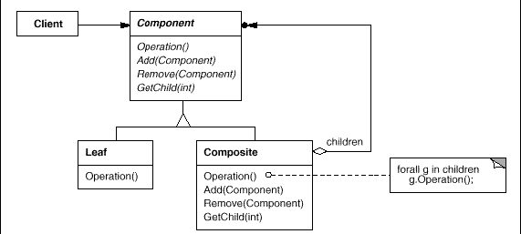
04/10/15 11/08/26
Composite
Structure

Slide 93
04/10/15 11/08/26
Composite
Applicability
  To represent part-whole hierarchies of objects
  Clients to be able to ignore the difference between compositions of objects and individual objects

Slide 94
04/10/15 11/08/26
Composite
Consequences
  Makes the client simple
  Makes it easier to add new kinds of components
  Can make your design overly general
    Cannot restrict a composite to have only certain components

Slide 95
UML
What is Design Patterns?
Adapter
Singleton
Factory method
Abstract Factory
Decorator
Observer
Command
Template Method
Composite
Prototype
Facade
MVC
Exercises

Slide 96
04/10/15 11/08/26
Prototype
Intent
  Specify the kinds of objects to create using a prototypical instance, and create new objects by copying this prototype

Slide 97
04/10/15 11/08/26
Prototype
Problem
  Abstract Factory helps create families of objects
    But Burdensome to create a new class for each family
  How to instantiate object of classes which are specified at run-time?
  How to easily create a copy of an existing object?

Slide 98
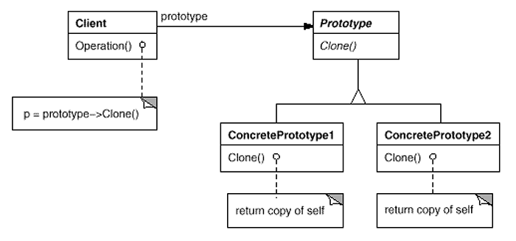
04/10/15 11/08/26
Prototype
Structure

Slide 99
04/10/15 11/08/26
Prototype
Applicability
  When a system should be independent of how its products are created, composed, and represented
  When the classes to instantiate are specified at run-time, for example, by dynamic loading
  To avoid building a class hierarchy of factories that parallels the class hierarchy of products
  When instances of a class can have one of only a few different combinations of state

Slide 100
04/10/15 11/08/26
Prototype
Consequences
  Prototype has many of the same consequences that Abstract Factory and Builder have
    Hides the concrete product classes from the client,
    reduce the number of names clients know about
    These patterns let a client work with application-specific classes without modification
  Additional benefits of the Prototype pattern
    Adding and removing products at run-time
      Effectively define new kinds of objects by instantiating existing classes and registering the instances as prototypes of client objects
    Specifying new objects by varying values
    Specifying new objects by varying structure
    Reduced subclassing
    Configuring an application with classes dynamically

Slide 101
UML
What is Design Patterns?
Adapter
Singleton
Factory method
Abstract Factory
Decorator
Observer
Command
Template Method
Composite
Prototype
Facade
MVC
Exercises

Slide 102
04/10/15 11/08/26
Facade
Intent
  Provide a unified interface to a set of interfaces in a subsystem
  Facade defines a higher-level interface that makes the subsystem easier to use

Slide 103
04/10/15 11/08/26
Facade
Motivation
Client classes
Facade
Subsystem classes

Slide 104
04/10/15 11/08/26
Facade
Applicability
  Provide a simple interface to a complex subsystem
  Decouple the subsystem from clients and other subsystems
  Layer your subsystems

Slide 105
04/10/15 11/08/26
Facade
Consequences
  Reduce the number of objects that clients deal with
    Make the subsystem easier to use
  Doesn't prevent applications from using subsystem classes if they need to

Slide 106
UML
What is Design Patterns?
Adapter
Singleton
Factory method
Abstract Factory
Decorator
Observer
Command
Template Method
Composite
Prototype
Facade
MVC
Exercises

Slide 107
04/10/15 11/08/26
MVC
Intent
  Decoupling data access, business logic, and data presentation

Slide 108
04/10/15 11/08/26
MVC
Problem
  A mixture of data access, business logic, and presentation code may cause several problems
    Such applications are difficult to maintain
  High coupling makes classes difficult or impossible to reuse
    They depend on so many other classes.
    Adding new data views often requires reimplementing or cutting and pasting business logic code

Slide 109
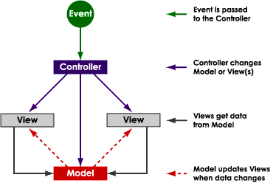
04/10/15 11/08/26
MVC
Solution

Slide 110
04/10/15 11/08/26
+------------+ | Model | +------------+ /\ . /\ / . \ / . \ / . \ / \/ \ +------------+ <------ +------------+ | View | | Controller | +------------+ ......> +------------+
+------------+ | Model | +------------+ /\ . /\ / . \ / . \ / . \ / \/ \ +------------+ <------ +------------+ | View | | Controller | +------------+ ......> +------------+
+------------+ | Model | +------------+ /\ . /\ / . \ / . \ / . \ / \/ \ +------------+ <------ +------------+ | View | | Controller | +------------+ ......> +------------+
MVC
Solution (cont.)
Model
View
Controller

Slide 111
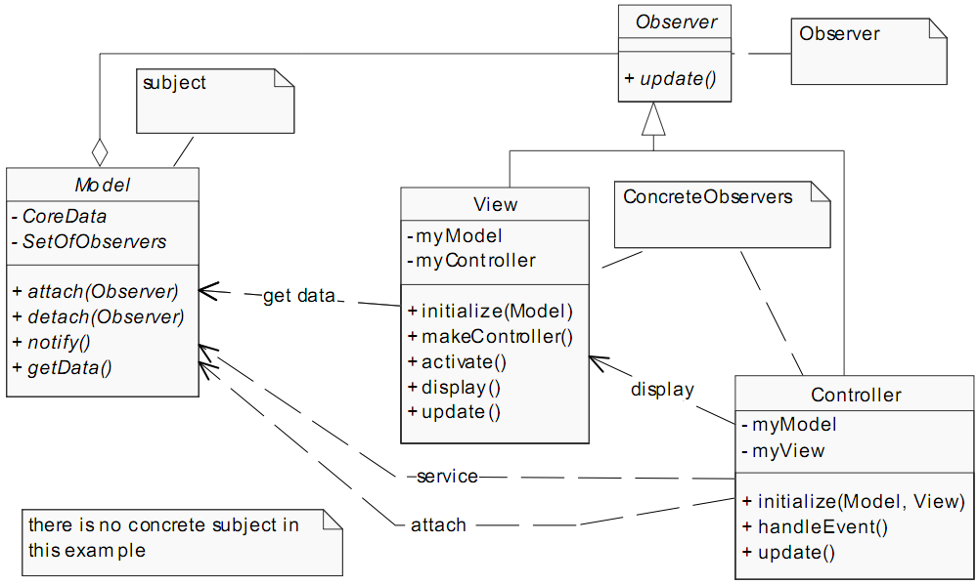
04/10/15 11/08/26
MVC
Structure

Slide 112
04/10/15 11/08/26
MVC
Applicability
  Used to de-couple your data, your presentation of the data and the logic for handling the events from each other

Slide 113
Contents
UML
What is Design Patterns?
Adapter
Singleton
Factory method
Abstract Factory
Decorator
Observer
Command
Template Method
Composite
Prototype
Facade
MVC
Exercises

Slide 114
04/10/15 11/08/26
Mediator

Slide 115
Others
Hook
public class Super {
protected void veryImportantInit() {
}
public void aMethod() {
// How can we force overriding method
// to have a call like this?
veryImportantInit();
}
}

Slide 116
Others
Hook
public class Super {
protected void veryImportantInit() {
}
public void aMethod() {
// How can we force overriding method
// to have a call like this?
veryImportantInit();
}
}
class Sub extends Super {
private void doSomething() {}
@Override
public void aMethod() {
// Sorry! I forgot calling your
// veryImportantInit method!
doSomething();
}
}

Slide 117
Others
Hook – solution
class Super2 {
protected void veryImportantInit() {
}
public final void aMethod() {
// This call will never be missed
veryImportantInit();
overrideable();
}
protected void overrideable() {
// do something else
}
}

Slide 118
Exercises
See Design Pattern Exercises.doc

Slide 119
Summary
Design Patterns help to isolate changes
Easy to maintenance code
  Increase flexibility
  Simplify logic
Standardization
Avoid duplication

Slide 120
References
Design Patterns - Elements of Reusable Object-Oriented Software (Gang of Four (GoF))
Applied Java™ Patterns (Stephen Stelting, Olav Maassen)
Design Patterns Java Workbook (Steven John Metsker)
Head First Design Patterns (Eric Freeman & Elisabeth Freeman)

